Slide 1

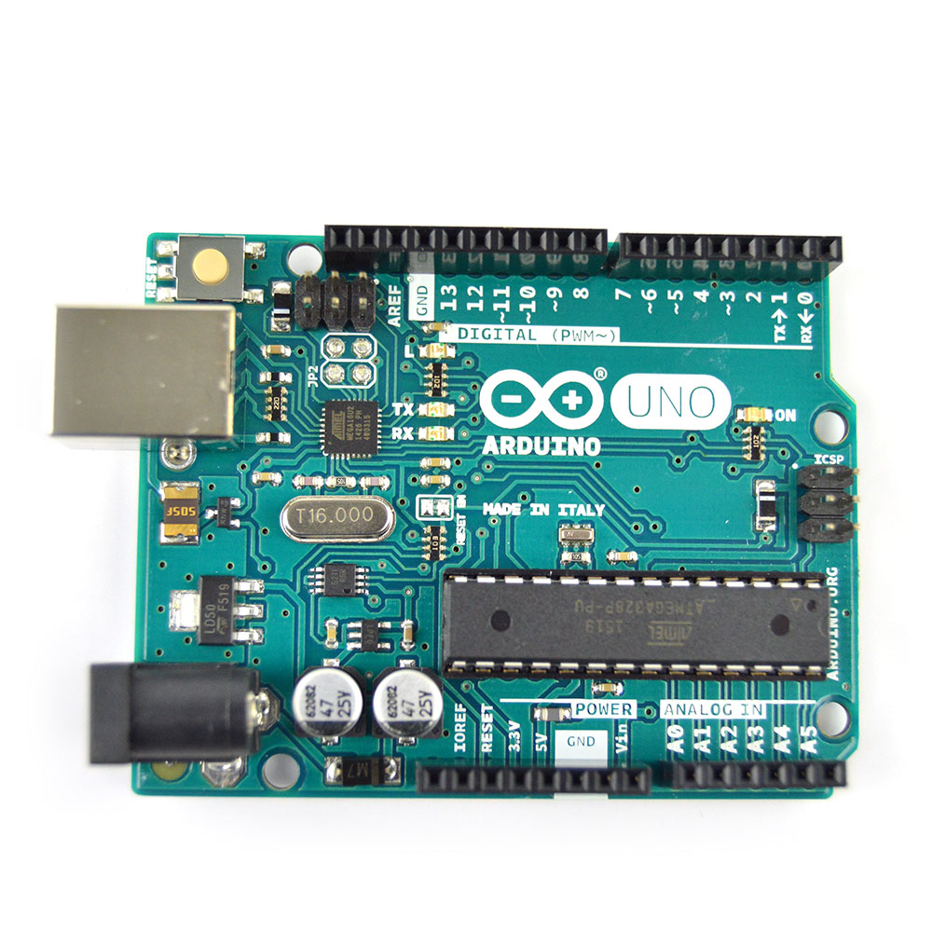
Architecture of Arduino development board
www.arduino.cc

Slide 2
What do you need to start working with Arduino?
1. Arduino board
2. USB cable
3. Computer with USB interface
4. USB driver and Arduino application
(to be downloaded from https://www.arduino.cc/en/software)

Slide 3
What is Arduino?
The Arduino is a programmable hardware board that runs an 8-bit /16 Mhz microcontroller with a special bootloader that allows users to upload programs to the microcontroller.
+ It has digital input pins for input from switches and output to Actuators (LEDS or electrical motors) + It also has analog pins to accept inputs from voltagebased sensors.
Arduino can be used to develop stand-alone interactive objects or can be connected to software on your computer.

Slide 4
What is Arduino? Open Source
Open Source Hardware The Arduino system is open source - all hardware (made by Arduino distributors) has the schematics and PCB layouts available online.
Open Source Bootloader The bootloader is what runs on the chip before the program is run. It boots the chip and executes the program.
Open Source Development Kit The development kit - what you use to program an Arduino board - is also available online. It is free, open-source.

Slide 5
Arduino Terminology
I/O Board - The I/O Board is the "brain" of the operation (main microcontroller you program it from your computer).
Shield - A Shield is a device that plugs into an I/O Board. These extend the capabilities of the I/O Board.
Sketch - A Sketch is a program written for the board and shields.
Sensor - components (Gas, etc.)
Modules - serial data (GPS module, etc.)
pin – an input or output connected to something.
Digital – value is either HIGH or LOW.
Analog – value ranges, usually from 0-255.

Slide 6
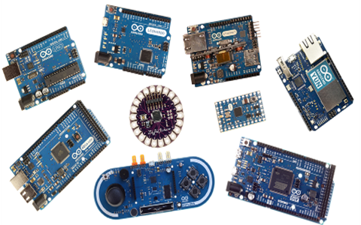
Arduino Types
Many different versions depend on the number of input/output pin or processor.
Uno (number one)
Leonardo
Due
Micro/Nano
LilyPad
Esplora
…

Slide 7
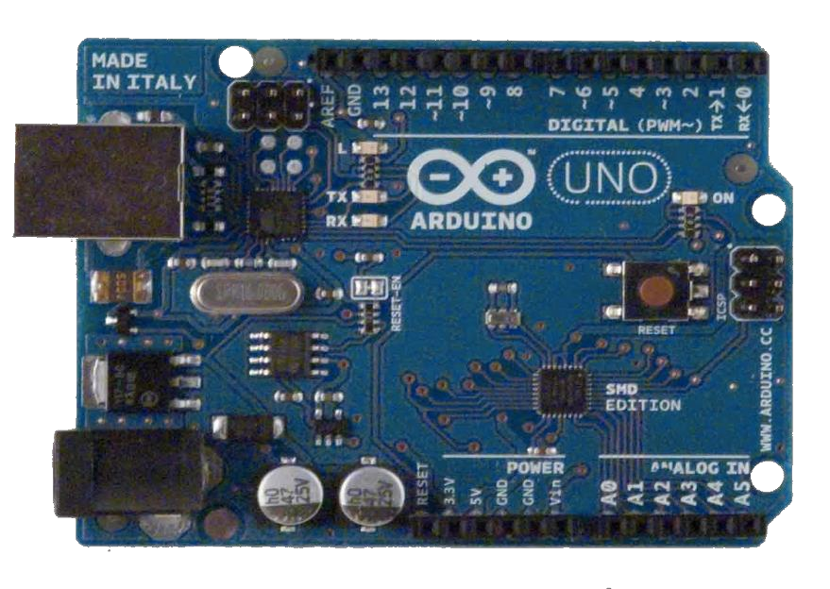
Arduino Uno
The pins are in three groups:
6 analog inputs
(can be used as digital outputs).
14 digital input/output pins
(of which 6 can be used as PWM outputs).
Power

Slide 8
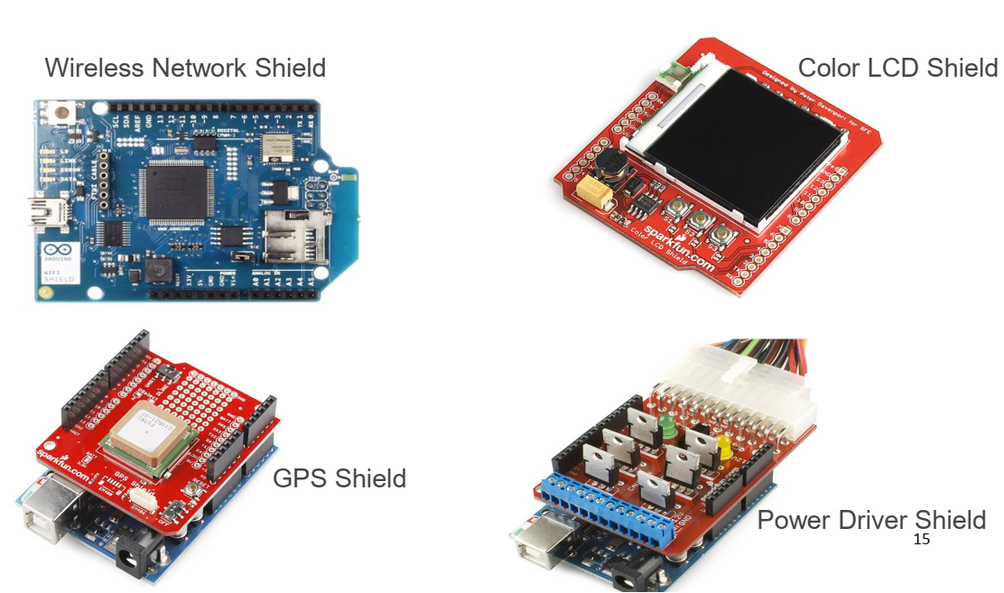
Shields
Shields connect to the I/O board to extend it's functionality.

Slide 9
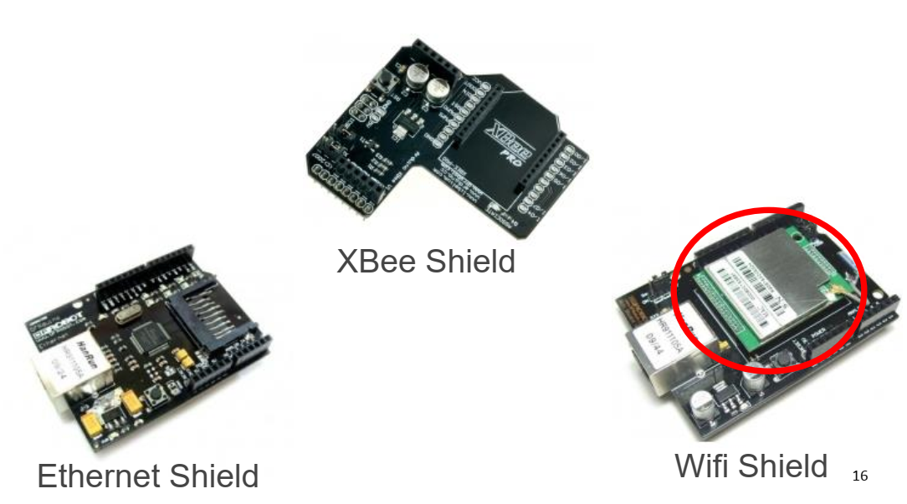
More Shields…
Communication shields - XBee, Ethernet, and Wifi

Slide 10
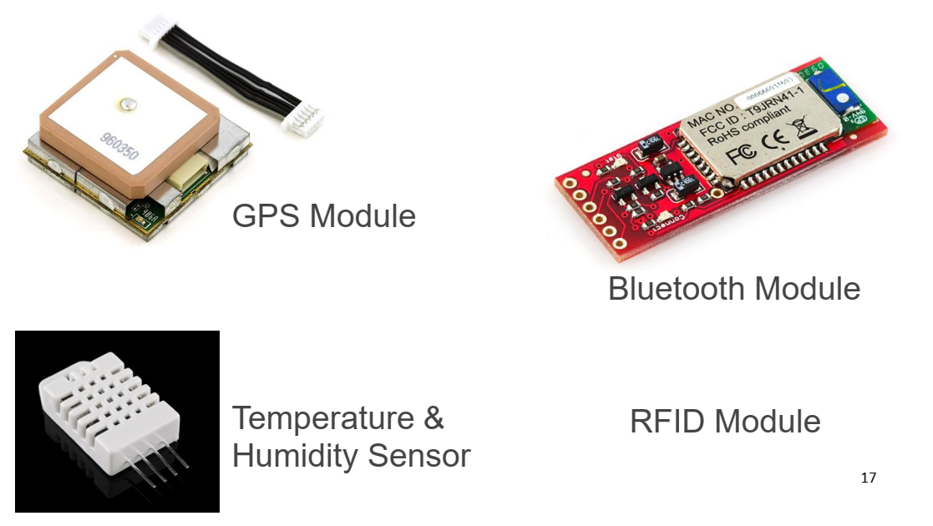
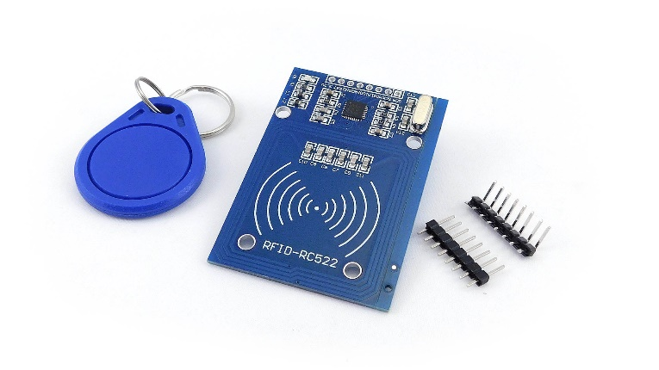
Modules
Modules send serial data strings to the Arduino.
RFID Module

Slide 11
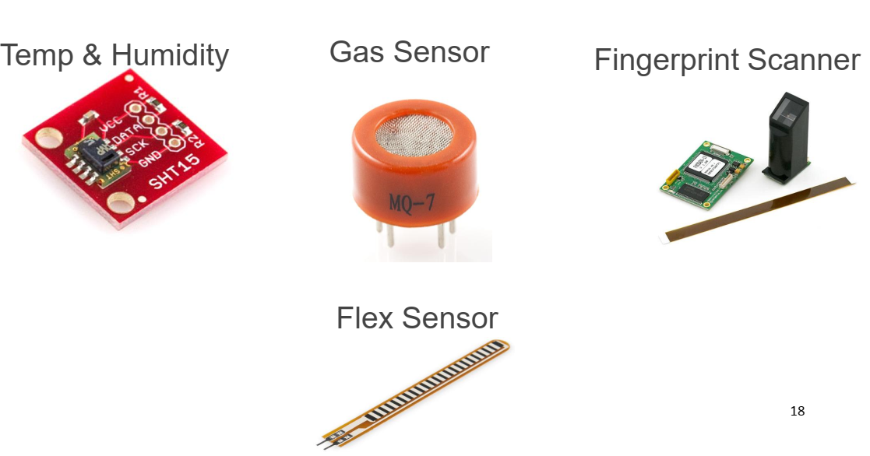
Sensors and Modules
Shields aren't the only way to extend an Arduino board - you can hook sensors to it!

Slide 12
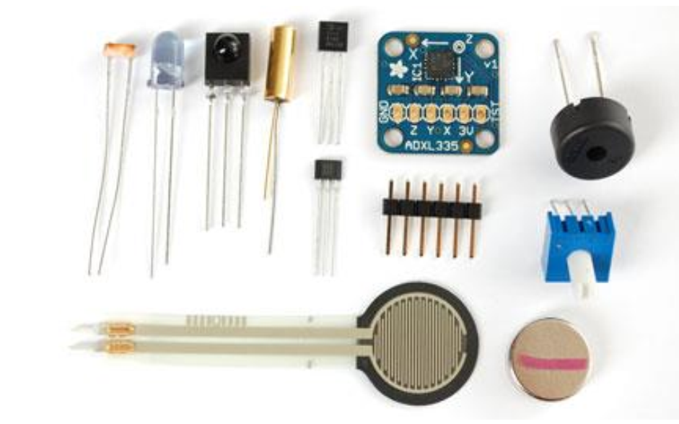
Sensors
Photoresistor, infared, force sensitive resistor, Hall effect (varies its output voltage in response to a magnetic field), Piezo, tilt sensor..

Slide 13
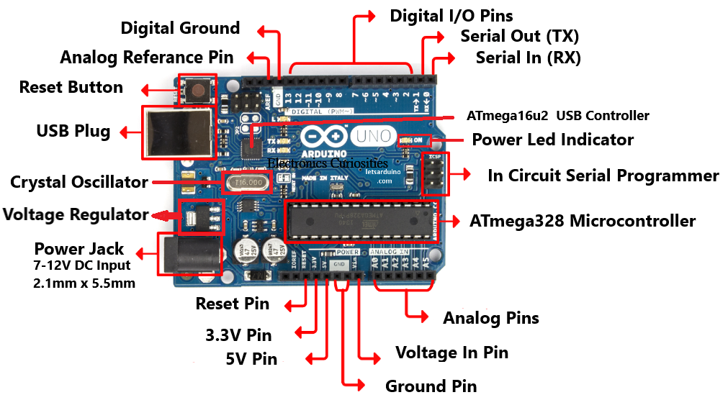
Arduino Uno Board Overview

Slide 14
Arduino Uno/ATmega328 Technical Specifications
Microcontroller ATmega328
Operating Voltage 5 V
Input Voltage
(recommended) 7-12 V
Input Voltage (limits) 6-20 V
Digital I/O Pins 14 (of which 6 provide PWM output)
Analog Input Pins 6
DC Current per I/O Pin 40 mA
DC Current for 3.3V Pin 50 mA
Flash Memory 32 KB (ATmega328) of which 2 KB used by bootloader
SRAM 2 KB (ATmega328)
EEPROM 1 KB (ATmega328)
Clock Speed 16 MH

Slide 15
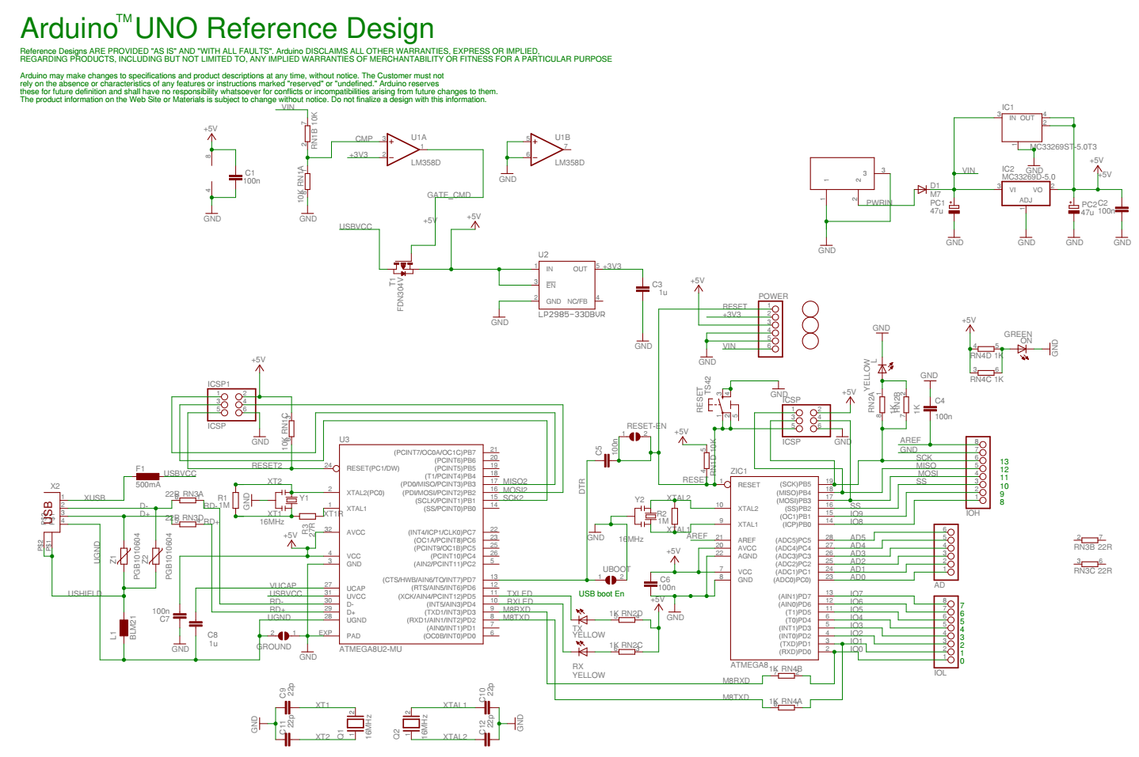

Slide 16
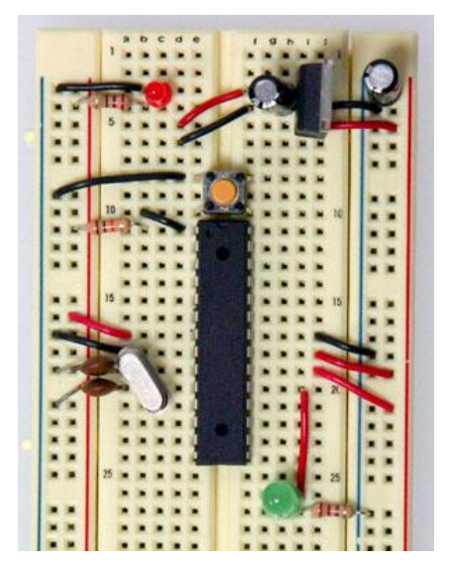
Components of the Arduino
• ATMega168/328.
• 16MHz crystal/filtering capacitors.
• Onboard power regulators.
• FTDI USB <-> Serial Chip.
• Hardware (Board).

Slide 17
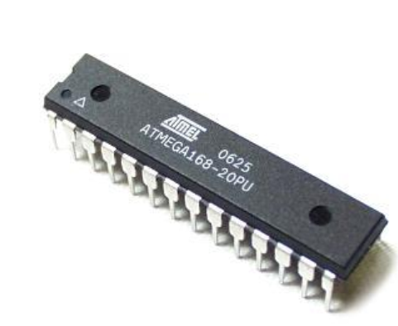
Necessary parts for any circuit
• ATMega168/328.
• The ‘brains’ of the Arduino.
• Program is loaded onto the chip.
• Runs main loop until power is removed.

Slide 18
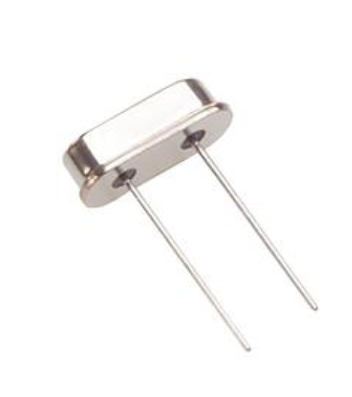
Timing
• 16Mhz Crystal.
• The ‘heartbeat’ of the ATMega chip.
• Speed of crystal determines chip speed
. • ATMega series has onboard oscillator.

Slide 19
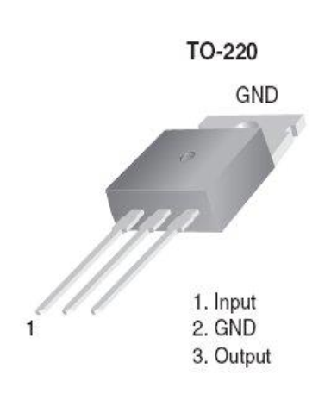
Power Supply
• 5 Volt and 3.3 volt regulators. • Filtering capacitors. • Automatic switching between external and USB Power. • Leave it out if you have a filtered 5 Volt power supply.

Slide 20
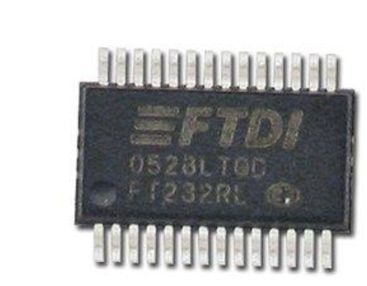
FTDI USB Chip
• Allows your Arduino to communicate with your computer over a simple USB link.
• ATmega16u2 replaces FT232RL for USB-serial communication / Arduino Uno R3

Slide 21
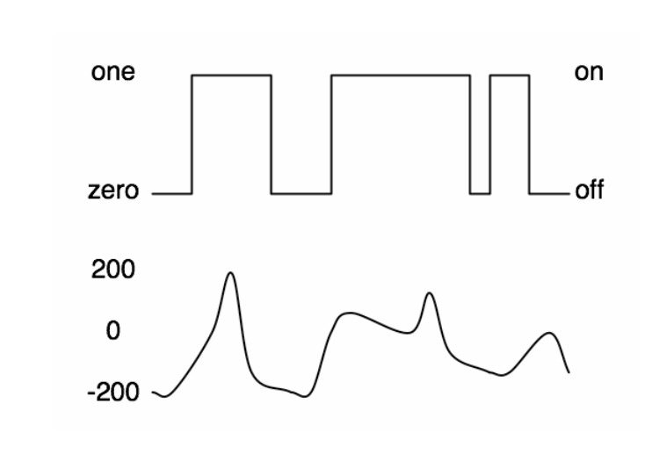
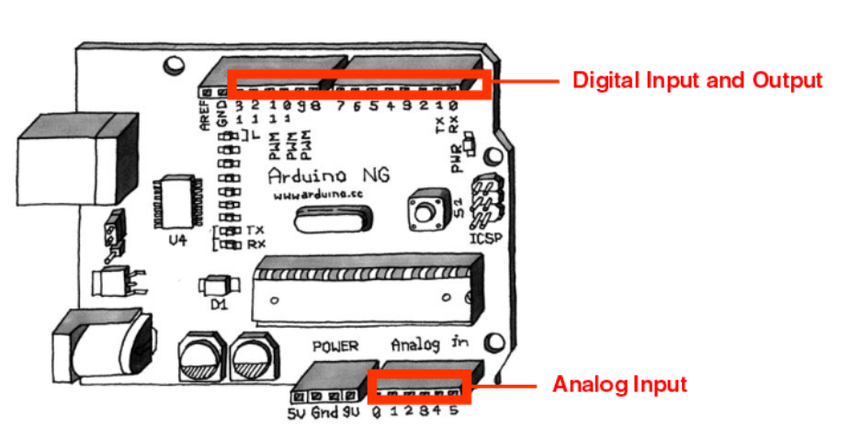
Digital or Analog
Digital – may take two values only: ON or OFF (1 or 0 / binary signal)
Analog – has many (infinite) values (continuous signal)
Output pins can provide 40 mA of current

Slide 22
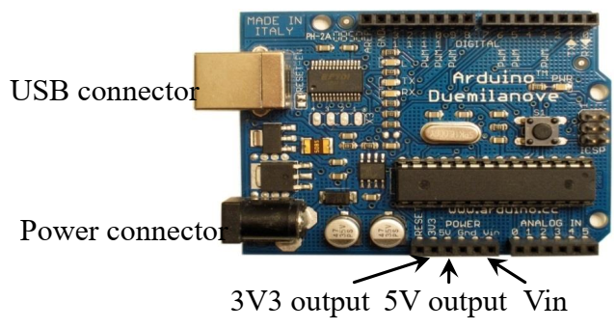
Input voltage to the Arduino board
The power pins are as follows:
Vin. The input voltage to the Arduino board when it's using an external power source (as opposed to 5 volts from the USB connection or other regulated power source). You can supply voltage through this pin, or, if supplying voltage via the power jack, access it through this pin. (7v-12v)
5V. The regulated power supply used to power the microcontroller and other components on the board. This can come either from Vin via an on-board regulator, or be supplied by USB or another regulated 5V supply.
3V3. A 3.3 volt supply generated by the on-board FTDI chip. Maximum current draw is 50 mA.
GND. Ground pins.

Slide 23
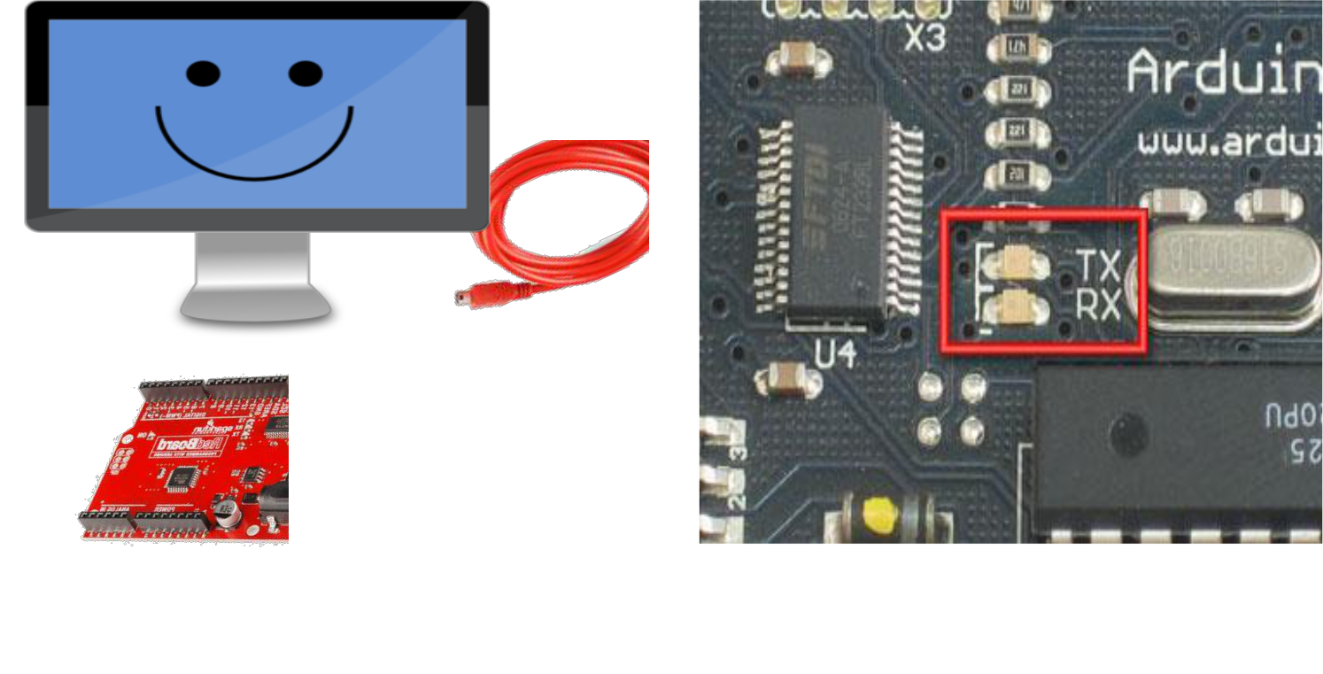
Serial Communication
RX blinks when the Arduino is receiving data.
TX blinks when the Arduino is transmitting data.

Slide 24
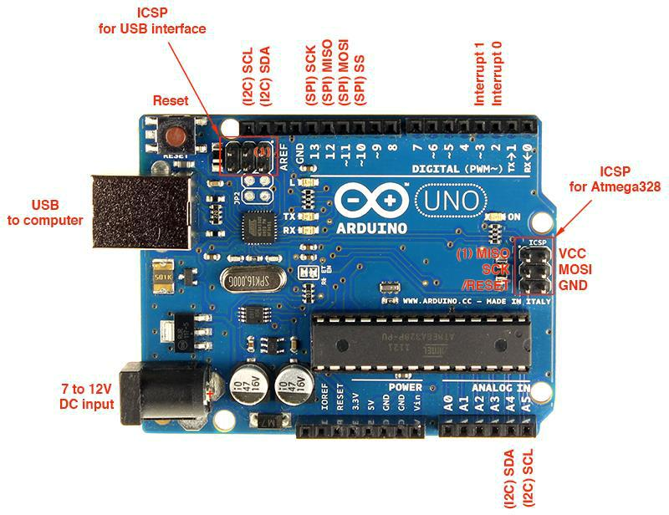
Serial data transfer with Arduino UNO
Universal asynchronous receiver/transmitter (UART)
Serial Peripheral Interface (SPI)
Inter-integrated Circuit (I2C) or Two-Wire Interface (TWI)

Slide 25
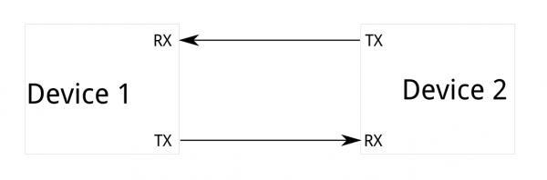
Serial Communication - UART
All Arduino boards have at least one serial port (also known as a UART). It communicates on digital pins 0 (RX) and 1 (TX) as well as with the computer via USB.
Used for communication between the Arduino board and a computer or other devices.

Slide 26
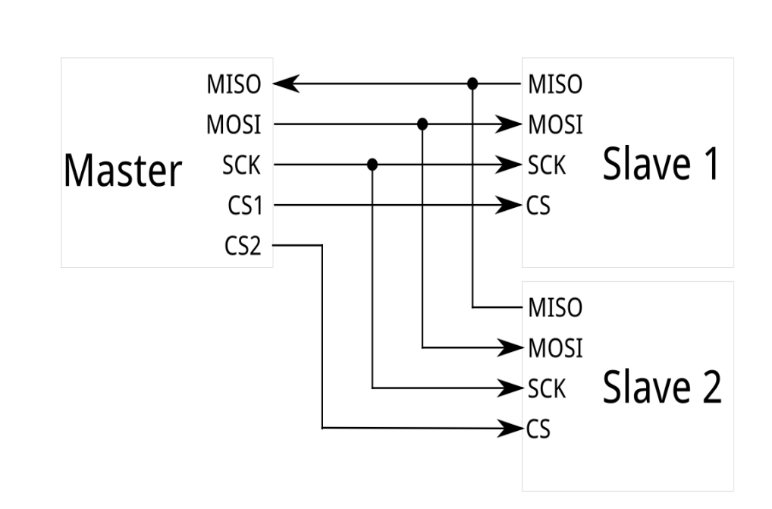
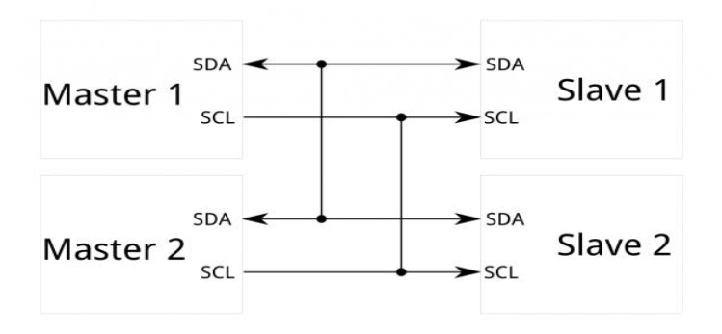
Serial Communication (other)
SPI I2C

Slide 27
Software Serial
It is possible to have multiple software serial ports (UART) with speeds up to 115200 bps.
If using multiple software serial ports, only one can receive data at a time.

